Slide 1
Welcome! Lewiston High School Senior Information Night October 1, 2018
Notes:
Lance

Slide 2
Senior Information Night Agenda
Welcome Remarks – Kevin Driskill, LHS Principal
Senior Party Information – Brenda Ross, Vice-Chairman, Parent Committee
Yearbook Information – Jennifer Stubbers, Yearbook Advisor
Senior Project Information – Emmett Dougherty, Government Instructor, Senior Project Committee
Graduation Caps, Gowns, and Announcements – Jake Lee, Idaho Recognition Products
Counselor Website Overview – Leslie Halliday, School Counselor
Advanced Opportunity for your Senior – Kaylin Roby, College and Career Advisor
Financial Aid– Tammy Hasenoehrl, School Counselor
College Admission Retests and Scores, College Application Week – Christina Cahill, School Counselor
College Admission– Soo Lee Bruce-Smith, LCSC
Work after High School, Certification, Apprenticeships, Associates Degrees- Dianne Hairston, Idaho Department of Labor
The Military Option-Sergeant First Class Austin Salazar, Army National Guard
Encouragement for Seniors and their Parents – Neil Williams, School Counselor
Adjournment, Individual Questions

Slide 3
Senior Party Information
Senior Party Information
Brenda Ross, Vice-Chair of the Safe and Sober Senior Party Committee
2018lhssafeandsober@gmail.com

Slide 4
Yearbook-Buy Now Online: $60 Price increase- December 1: $70
Senior Pictures, Ads, Quotes
DUE: November 15
Purchase yearbook: yearbookforever.com
Submit senior portrait: yearbookforever.com Registration pictures will be used if the deadline is missed.
Helpful LHS Website links: https://www.lewistonschools.net/lhs/yearbook/

Slide 5
Senior Project Components
Emmett Dougherty, Government Instructor, LHS Senior Project Committee

Slide 6
Senior Project Dates:
Access Teacher Form March 22
Field Experience – In Portfolio by April 5
Project Verification – In Portfolio by April 5
Reflective Letter – In Portfolio by April 5
Portfolio – April 5
Practice Presentation – April 9
Final Presentation – April 17

Slide 7
Getting Started:
Field Experience can be done at any time
Students should think through the entire project from start to finish when selecting field experience.

Slide 8
Major Components
I. Research Paper:
A 4-6 page researched and documented paper that contains at least 4 sources and follows MLA format.
This paper will be assessed and graded in their English 12 class and added to their portfolio.

Slide 9
Major Components
II. Field Experience:
With the second component seniors will select some sort of hands-on experience (a job shadow, volunteer work, creating a product, etc.) that relates to the topic they researched and requires them to spend at least 15 hours using knowledge gained from that research and incorporates guidance from a community mentor.

Slide 10
The field experience must connect with the paper. It is a much easier task to match a research paper to a field experience.
Another factor that should be considered is time management. The project needs to be one that the student can complete while finishing senior courses, working, playing sports, or doing other extracurricular activities.

Slide 11
Major Components
III. Reflective Letter and Portfolio
Portfolio with a reflective essay, will be a binder containing all documents pertaining to the Senior Project process.
The portfolio will be graded in their Government class and viewed by a panel of judges prior to their presentation.

Slide 12
Major Components
IV. Presentation
The fourth component is an 8-12 minute presentation of the entire Senior Project which will be delivered to a panel of judges. A question and answer period will follow each presentation.
All senior project information and forms can be found online at the LHS web site

Slide 13
The final presentation should answer these questions:
1. What was the research paper?
2. What was the subject of the field experience?
3. What is the connection between the paper and the field experience?
4. What was the “stretch” for the student? That is, what did he or she
do that was not known or done before?
5. Are there any applications for the future from this project?

Slide 14
Sr. Project Judges
This years Senior Project presentations will be given on April 17th starting at 1:00
We are always looking for people who are willing to come in and give up an afternoon to help with the judging of the projects.

Slide 15
Caps and Gowns
Online Order Deadline: April 1st
December 15 Order Deadline
Make checks out to Idaho Recognition Products including 6.0% tax.
Order online at idgrad.com
Email sales@idahorecognition.com
Phone 208-941-1602
Notes:
Leslie

Slide 16
Counseling Center Overview
https://www.lewistonschools.net/lhs/counseling-and-career-center/

Slide 17
Advanced Opportunities
Kaylin Roby, College and Career Advisor
State program allocates $4,125 for each student:
Dual credit courses (up to $75 per credit)
Advanced Placement (AP) tests
Overload courses (up to $225)
Professional Certification exams
Dual credit; $65/credit when taken at LHS, $85/credit when taken at LCSC; student responsible for books, lab & course fees at LCSC
Student is responsible for anything above $4,125.
To access funds, set up an account at https://advancedops.sde.idaho.gov/.

Slide 18
Year-Long Dual Credit Courses offered at LHS
Algebra 2 PTE
Anatomy
Astronomy
Honors Biology
Math 147
Geology
Forensics
Painting
Probability and Statistics
Psychology
Spanish 3
Spanish 4
Intro to Computer Science

Slide 19
One Semester Dual Credit Courses offered at LHS
DAYO
FAST
Fitness/Wellness
MAP
Physical Fitness Advanced
Sports and Recreation
WSSA
Racquet Sports
Volleyball
Macro Economics
Micro Economics
Intro to Teaching
Sports Medicine

Slide 20
Dual Credit Scholarships
Postsecondary Credit Scholarship
Criteria:
10 or more college credits before graduation
Matching Industry Merit Based Scholarship
Award is $2000 (over four semesters) for 10-19 dual credits, $4000 for 20+ dual credits, $8000 for Associates Degree
LCSC Dual Credit Scholarship
Criteria:
10 or more college credits through LCSC before graduation (must have passed all dual credit classes)
Enroll at LCSC immediately after high school
Minimum 2.5 GPA in high school
$500 award (non-renewable)

Slide 21
1. Federal aid – FAFSA 2. Scholarships – local, state, and national 3. University/College Scholarships
Three main sources of
financial assistance for college

Slide 22
Federal Aid - FAFSA
Used to qualify for work study, grants, and loans
Apply for FSA ID, this fall (both student and parent)
Complete as soon as you can after October 1st. You can use the IRS Data Retrieval Tools which directly inputs your taxes into FAFSA
www.fafsa.ed.gov (NEVER PAY FOR A FAFSA)
Use the My Student Aid App – research colleges and fill out FAFSA application

Slide 23
College or University Scholarships
Visit with college representatives at LHS
Visit each of these offices on campus
Financial aid office
Admissions
Program of study
Student services
Representatives of these offices often make scholarship decisions!

Slide 24
Scholarships – local, state, national
Take advantage of scholarships: elementary school, junior highs, businesses, church, and various clubs and civic organizations. All scholarship dollars add up.
Many of these opportunities come in after the middle of January.
Websites and Bengal Green Counseling Center Scholarship Link

Slide 25
Additional Scholarship Tips
resume
list goals/objectives
Have someone who knows you well look over to make sure nothing is missing
Apply for scholarships outside your range of interest. Sometimes there are very few applicants.
Be aware of deadlines
Keep a copy and date of scholarships submitted
letters of recommendation
ask at least two weeks prior to the deadline
different sources
Send a thank you
Notes:
Leslie

Slide 26
Short Video on Financial Aid: A bit more about Financial Aid

Slide 27
Financial Aid Workshops
Parent financial aid workshops date options on
Monday, October 1st at 6:30 pm in Room 208
Tuesday, October 23rd at 3 pm Counseling Center
Thursday, October 25th at 3 pm in Counseling Center
Monday, February 11th at 7 pm in Room 208

Slide 28
College Entrance Exams
Admission
Combination of Test Scores and GPA
Placement in College Classes
LCSC (EBRW-500, Math-510)
U of I (English-510, Math-510
BSU (English-Writing Assessment, Math-430)
Next SAT Test Date November 3
Register by October 5 at www.collegeboard.com/sat
Option to take the ACT (register at www.actstudent.org)
Scores are on Transcripts
Some schools require official reports

Slide 29
Idaho College Application Week
October 22nd-26th
One block in each Government class to work on college applications or resume/job applications.
Family College Night on October 22 from 5-8pm. Pizza provided at 5pm: Information Booths open at 5PM; Breakout Sessions at 5:30PM. Come meet representatives from colleges such as LCSC, UofI, BSU, NIC, WSU, EWU, TVCC, Military Branches and MORE.
Breakout Sessions on Admissions, FAFSA, Finding the Right Fit, & MORE.

Slide 30
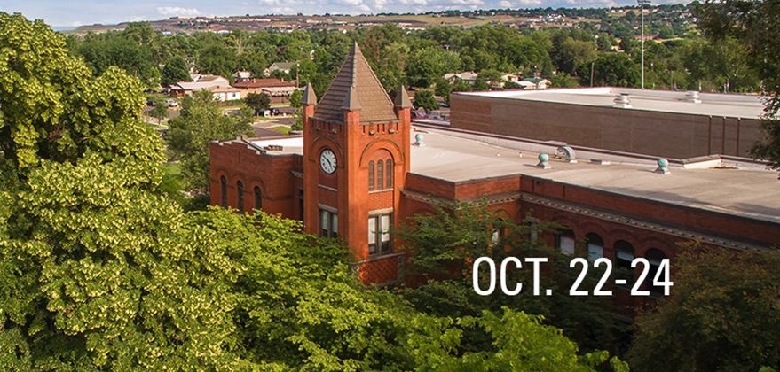
College Admission
Soo Lee Bruce-Smith, LCSC

Slide 33
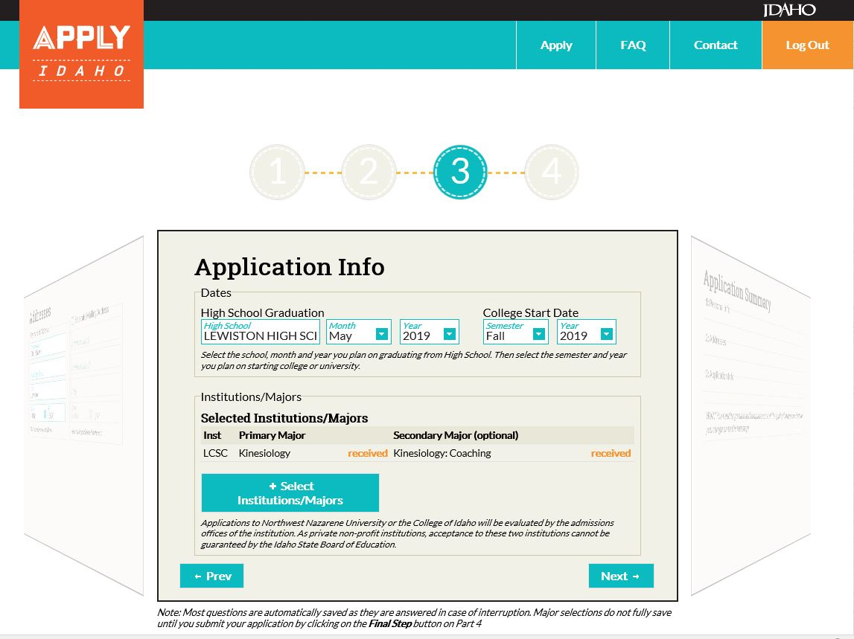

Slide 34
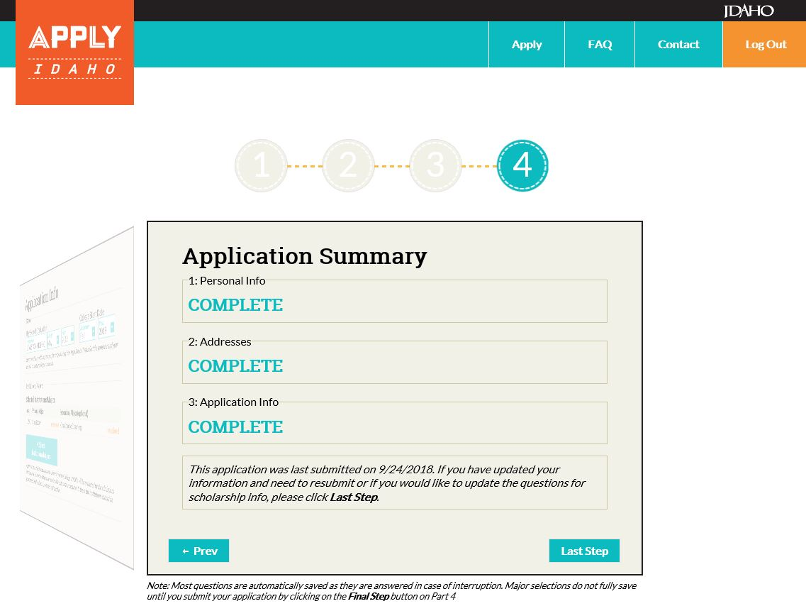

Slide 35
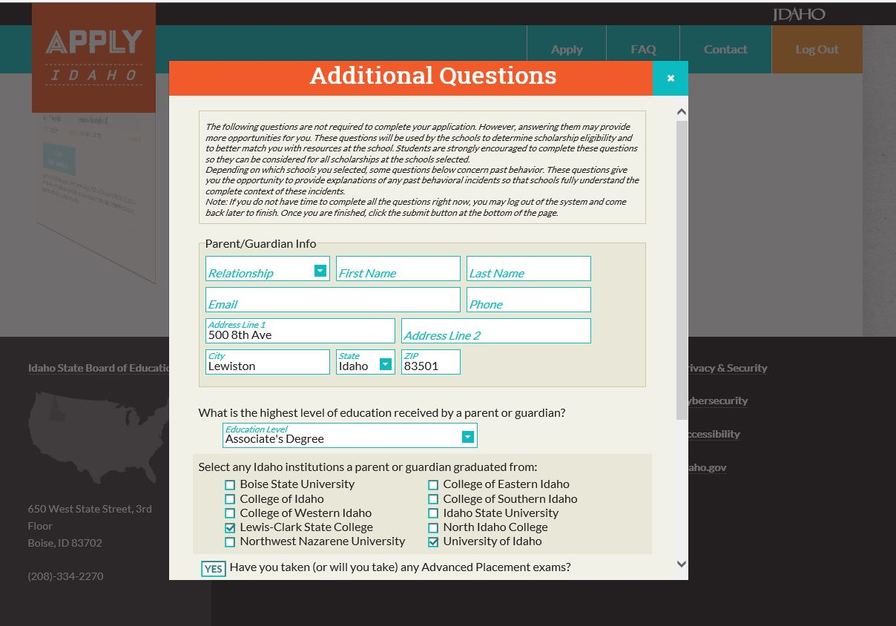

Slide 36
JOBSCAPE – a Career Search Tool
Explore Idaho’s landscape of opportunity and growth.
JobScape is an easy-to-use tool to help job seekers and students make informed career and educational decisions through access to education, career and labor market information specific to Idaho.
You don’t need an account, there‘s no log-in, just go to:
https://labor.idaho.gov/JobScape/
Come to the Idaho Department of Labor if you want help to:
Find a job
Connect to Apprenticeships or other on-the-job learning opportunities
Assist with short term training programs
Idaho Department of Labor
1158 Idaho Street / Lewiston, ID 83544

Slide 37
Job Scape
JOBSCAPE – A Career Search Tool
Some of the Information you will find on OCCUPATIONS:
Job Titles related to the occupation (different companies have different job titles)
Entry level education required (what level of training do you need?)
Typical hourly/annual wage (How much will you be earning?)
Annual job openings statewide
Current number of people employed in the occupation
Programs of study in Idaho and links to the school websites
Find out what schools offer the training you need for these occupations and what degrees are needed – 1 year certificates? 2-4 year degrees? Apprenticeships?
Link to current job openings listed with the Idaho Department of Labor

Slide 38
Sergeant First Class Austin Salazar, Idaho National Guard The Military Option austin.j.salazar.mil.@mail.mil

Slide 39
College Savings Plan
Ideal-Idaho College Savings Program
Tax benefits for college saving:
www.idsaves.org
Christine Stoll
cstoll@idsaves.Idaho.gov
(208) 332-2935

Slide 40
Encouragement for Seniors and their Parents, Neil Williams, Counselor
Encouragement for Seniors and Parents
Always stay flexible,
Plan A and B
It’s not wrong to change your mind
Know your options
Be realistic but positive

Slide 41
Contacts
Brenda Ross, Vice-Chair Senior Parent Committee 509-552-1431
Emmett Dougherty, Senior Project
edougherty@lewistonschools.net
Jennifer Stubbers, Yearbook
jstubbers@lewistonschools.net
Jake Lee, Idaho Recog. (Caps and Gowns)
sales@idahorecognition.com

Slide 42
Contacts, Continued
Soo Lee Bruce-Smith, LCSC
slbruce@lcsc.edu 208-792-2378
Christine Stoll, Ideal Savings Plan
cstoll@idahosaves.Idaho.gov
Karen Kerns, Registrar (For Transcript Requests)
kkerns@lewistonschools.net, 208-748-3114

Slide 43
Contacts, continued
Contacts, Continued
Diane Hairston 208-799-2000 Ext 5000
dianehairston@labor.idaho.gov
Austin Salazar 208-553-3931
austin.j.salazar.mil@mail.mil

Slide 44
Thank you for attending our Senior Presentation!
Notes:
Tammy

