Slide 1
Welcome to Jenifer Junior High!

Slide 2
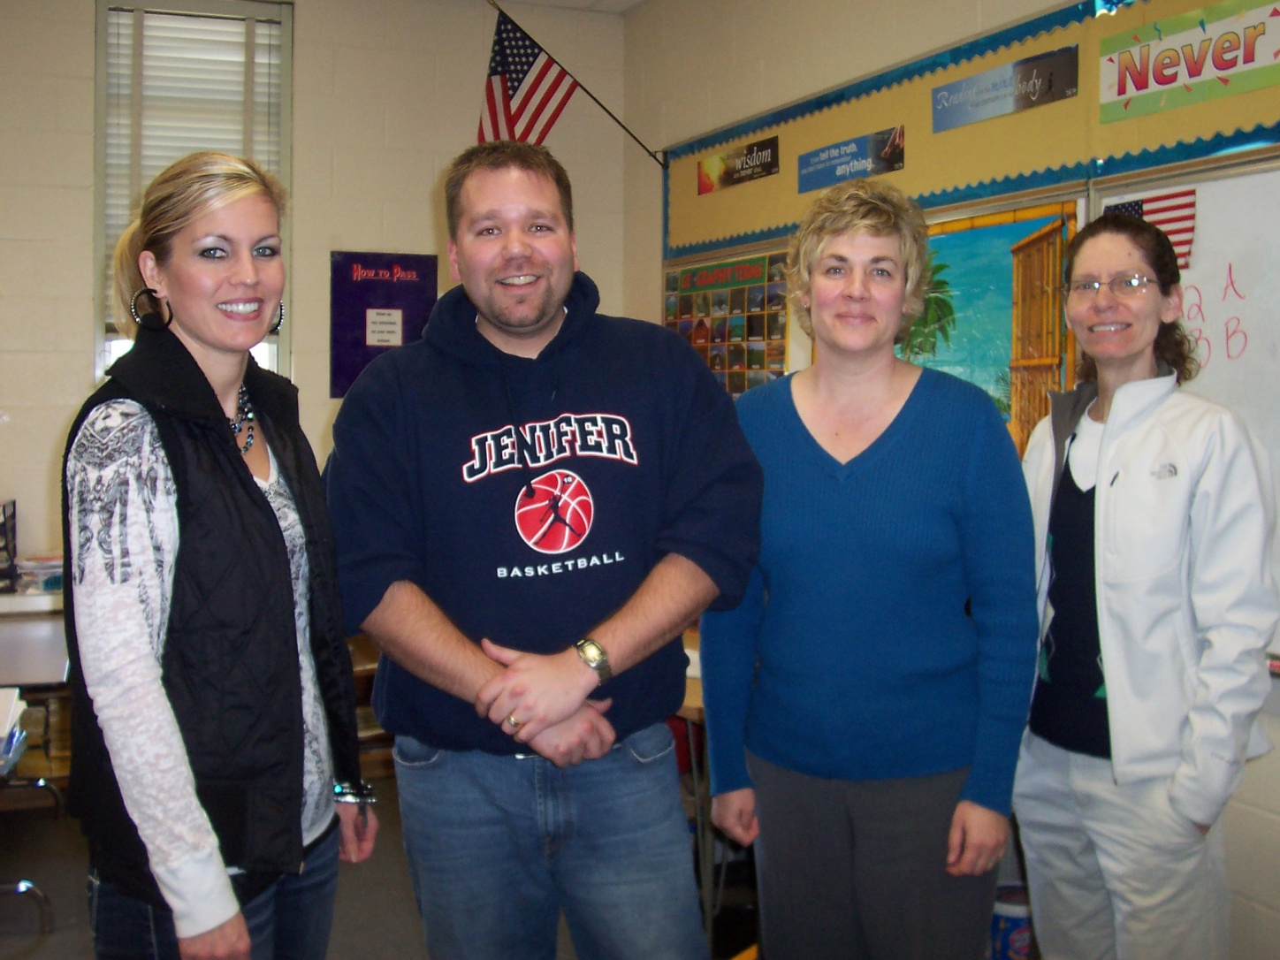
South Team
Mrs. Roberts (Social Studies), Mr. Miller (English),
Mrs. Burr (Math), Mrs. Kirking (Science)

Slide 3
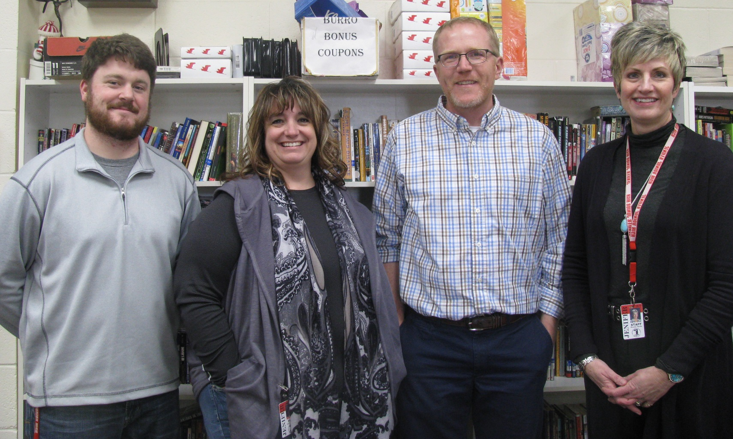
North Team
Mr. Peterson (Math), Mrs. Stamper (English)
Mr. Norwood (Science), Mrs. Hardin (Social Studies)

Slide 4
Schedule 8:20 – 2:56
A Days
B Days
Advisory
Exploratory
A1 Language Arts
Lunch
A2 World Geography
Elective
IU
Advisory
Exploratory
B1 Pre-Algebra
Lunch
B2 Life Science
Elective
IU

Slide 5
Electives
Intro to Art (semester)
Literature (semester)
Computer Technology (semester)
Physical Education (semester)
Orchestra (year long)
Band (year long)
Chorus (year long)
Jazz Band (Audition/Zero hour at 7:15)

Slide 6
Advanced Opportunities
Students in grades 7-12 attending public school in Idaho have access to $4,125 to use toward the cost of:
Overload Courses
Dual Credits (as an LHS student)
Exams

Slide 7
Lockers
Students have their own lockers (students are not allowed to switch lockers without asking permission)
Built-in locks
Locker/combination is assigned on the first day of school
Keep your locker locked!
Notes:
Breakfast

Slide 8
Breakfast 7:30 – 8:00 (optional) Lunch 11:03 – 11:38
Football
Basketball
Four Square
Library (students must have a pass)
Socialize with friends

Slide 9
Extra-Curricular Activities
You must have the following forms completed prior to practicing: Physical, Health Questionnaire, Pay to Participate
Must be passing 5 of your classes
Pay to Participate ($25.00/sport)
Fall Sports: Cross Country, Football, Volleyball
Late Winter Sports: Boys & Girls Basketball, Wrestling
Spring Sports: Track, Cheerleading
The following activities do not require the forms listed above:
Theatre (Audition)
Student Council
Art Club
Club SODA (Thursday at 7:50 am)

Slide 10
Policies
Cell phones
Hats
Dress code
Attendance
Technology

Slide 11
Parent/Teacher Communication
Assignment Notebook
Parent Calendar
Bi-weekly grade reports
Parent Portal
E-mail/phone
Parent/Teacher meetings

Slide 12
Study Time
Teachers 3:00 to 3:30
Library: Monday – Friday
3:00 to 3:45
Quiet Study Room: Monday – Thursday
3:00 to 4:00
Academic Academy: Thursday
3:00 to 5:00

Slide 13
Organization
Develop a system that works well for your student
A place and time to complete homework
Binder
Folders

Slide 14
Registration Schedule
March 1st: Parent Portal Open for Online Registration at home
March 7th – March 23rd: Classroom Visits
May 23rd: 6th Grade Orientation at JJH
August 10th: 7th Grade Registration

Slide 16
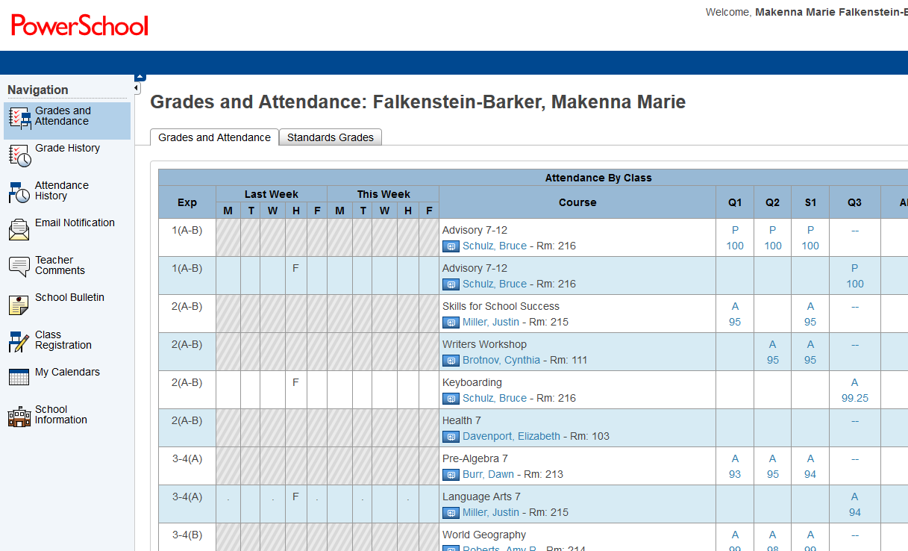
PowerSchool Registration
Click on Class Registration
Include Student’s Name in Subject
Parent/Student Portal ID and Passwords stay the same

Slide 17
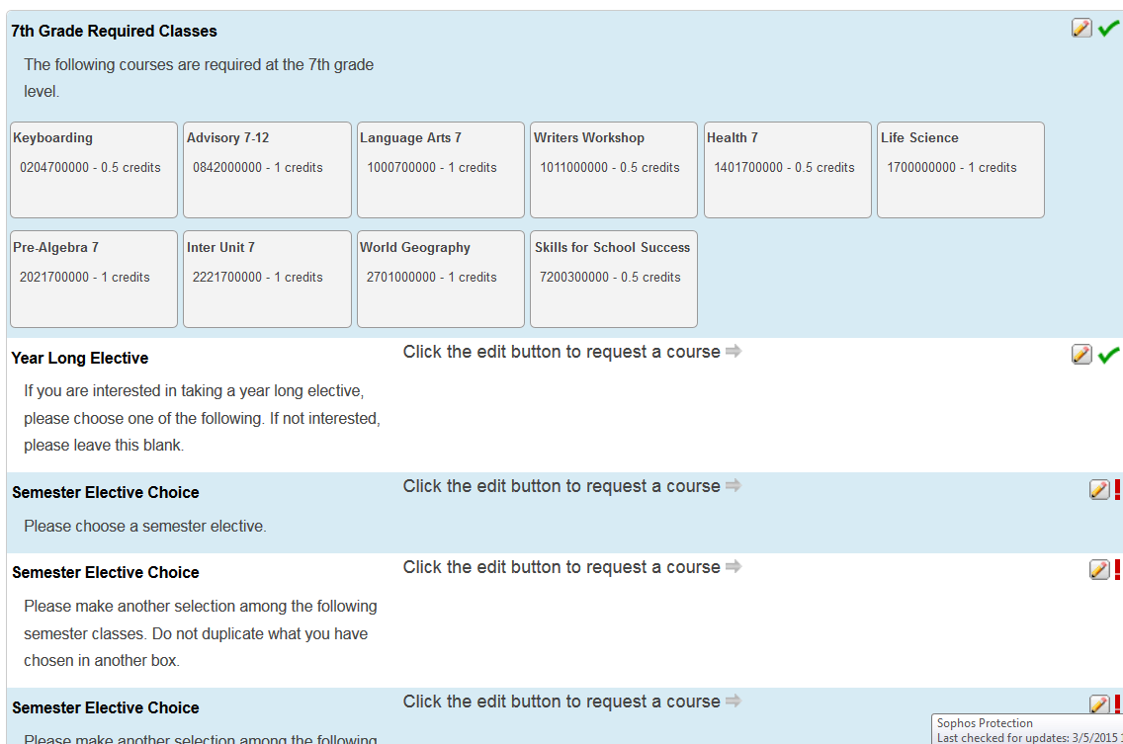

Slide 18
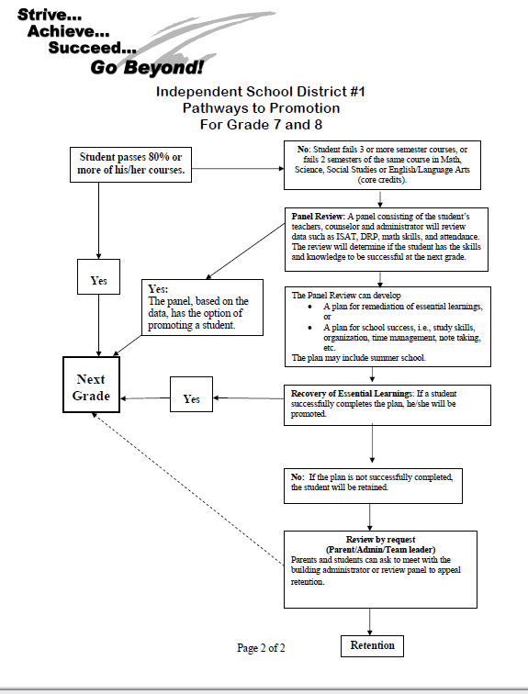
Pathways to Promotion Policy

Slide 19
Immunizations needed
7th Grade Immunization Requirements:
Children admitted to 7th gr. must meet the following minimum requirements in addition to school entry requirements:
One dose: Tetanus, Diphtheria, Pertussis (Tdap booster)
One dose: Meningococcal

Slide 20
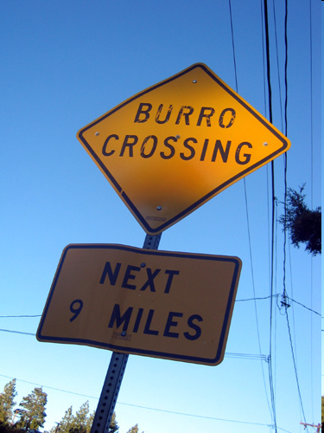
See You in August!

