Slide 1
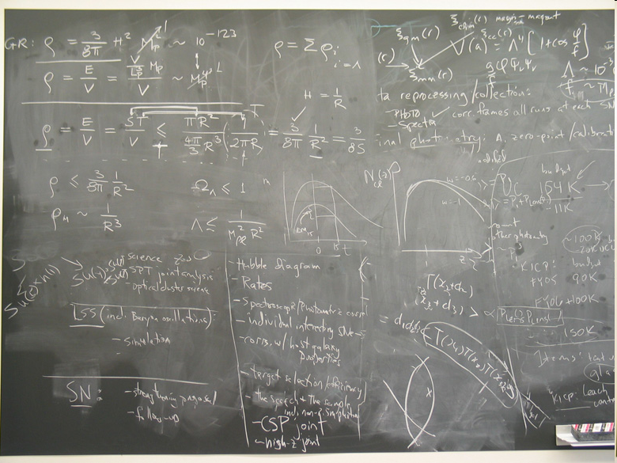
9th Grade Registration

Slide 2
Changes at 9th Grade
Graduation Requirements
8 credits English
1 credit Reading
1 credit Speech
6 credits Math (Algebra, Geometry, Senior Math)
6 credits Science
2 credits US History
1 credit US History 10
1 credit World History
1 credit Economics
1 credit Social Science
2 credits US Government
3 credits Physical Education
1 credit Health
2 credits Humanities
2 credits Professional Technical
1 credit Technology
15 credits Electives
ACT/SAT
Senior Project
ISAT 2.0
Biology or Chemistry EOC
Civics Assessment
54 Total Credits Required
  No Block Schedule
  GPA
  Advanced Opportunities
  Credit Requirements
    Minimum of 9 credits to go to LHS – any failed classes will require summer school the following summer

Slide 3
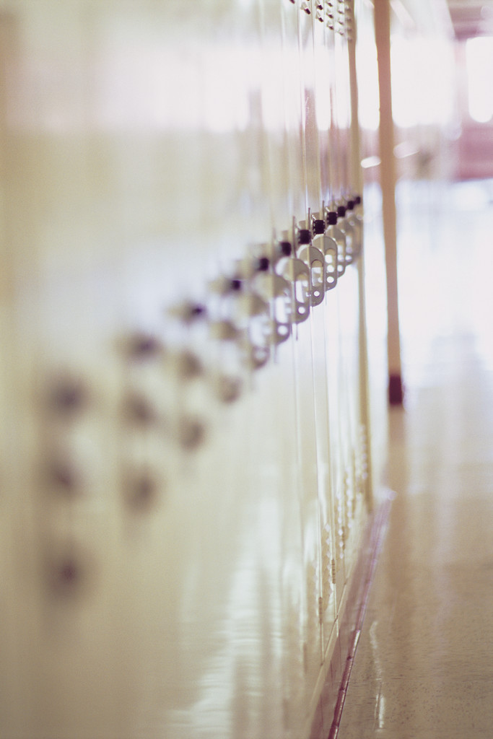

Assistance from teacher
Scheduled with
teacher
Learning Lunch
Friday Circle
Access
*On Wednesdays from
12:00 – 12:30
Powerschool Progress Reports
Every two weeks
Powerschool Parent Portal
https://pspublic.lewistonschools.net/public/
Library
During lunch and after school until 3:45

Slide 4
Bell Schedule: Access Schedule
(Wednesdays):
Period | Time
1 | 8:20 – 9:22
2 | 9:26 – 10:23
3 | 10:27 – 11:24
4 | 11:28 – 12:25
Lunch | 12:25 – 12:54
5 | 12:58 – 1:55
6 | 1:59 – 2:56
Period | Time
1 | 8:20 – 9:15
2 | 9:19 – 10:09
3 | 10:13 – 11:03
4 | 11:07 – 11:57
Access | 12:00 -12:30
Lunch | 12:30 – 1:05
5 | 1:09 – 1:59
6 | 2:03 – 2:56
Teachers will have students assigned to their access time (similar to advisory).
Students will be allowed to go to work with another teacher if their assignment notebook is signed by that teacher
Students are expected to work on assignments or read.

Slide 5
Athletics
Opportunities
  Football-LHS
  Cross Country-LHS
  Volleyball
  Soccer-LHS
  Basketball
  Wrestling-LHS
  Cheerleading
  Spring sports are all through LHS—track, softball, baseball, tennis, golf
Eligibility
  Eligibility is based on Idaho High School Activities Association requirements.
  Students must pass 5 of their 6 semester classes to be eligible.
Academic Assistance Program
  Students must earn a 70% or higher in every class
Physical Exam---must renew after May

Slide 6
Attendance Policy
Absences
  After the 12th absence, students may be required to make an appeal to the attendance committee.
  Parents will be notified in writing when student has reached 6 and 12 absences in one or more classes.

Slide 7
Reading Test Out
Lewiston School District graduation requirements permit students to receive credit and a “P” grade if they meet the following performance criteria in the 8th grade
    9.5 grade level equivalency on the Nelson Denny
    63 independent reading level on DRP
    A third indicator may be used

Slide 8
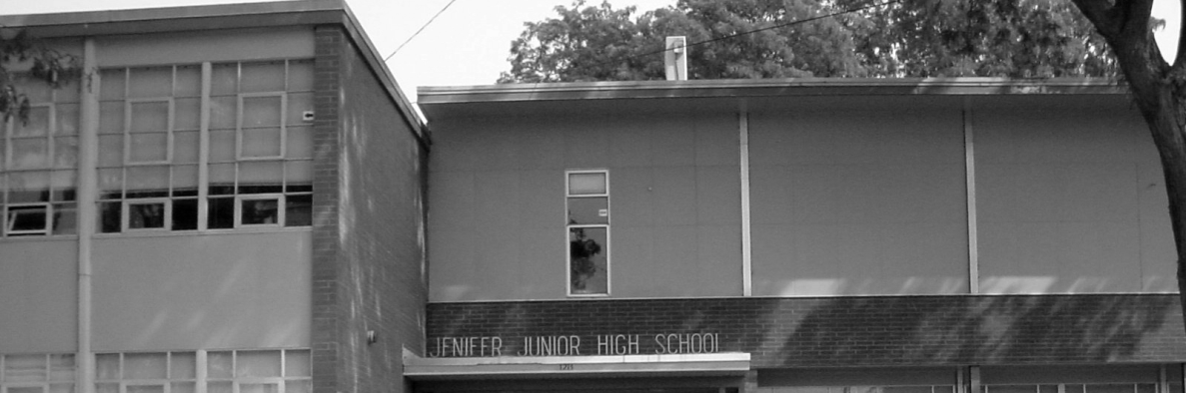
Math Placement
Geometry or Algebra 1
  Students will be placed in Geometry if currently in Advanced Math and maintaining 80% or higher
  All other students will be placed in Algebra 1

Slide 9

Registration Dates
March 6th-10th: Students will be receiving blue registration forms during their IU class
March 6th-24th: Parent Portal will be open
March 22nd-24th: On-line registration in our computer lab
August 8th: 9th grade registration

Slide 11
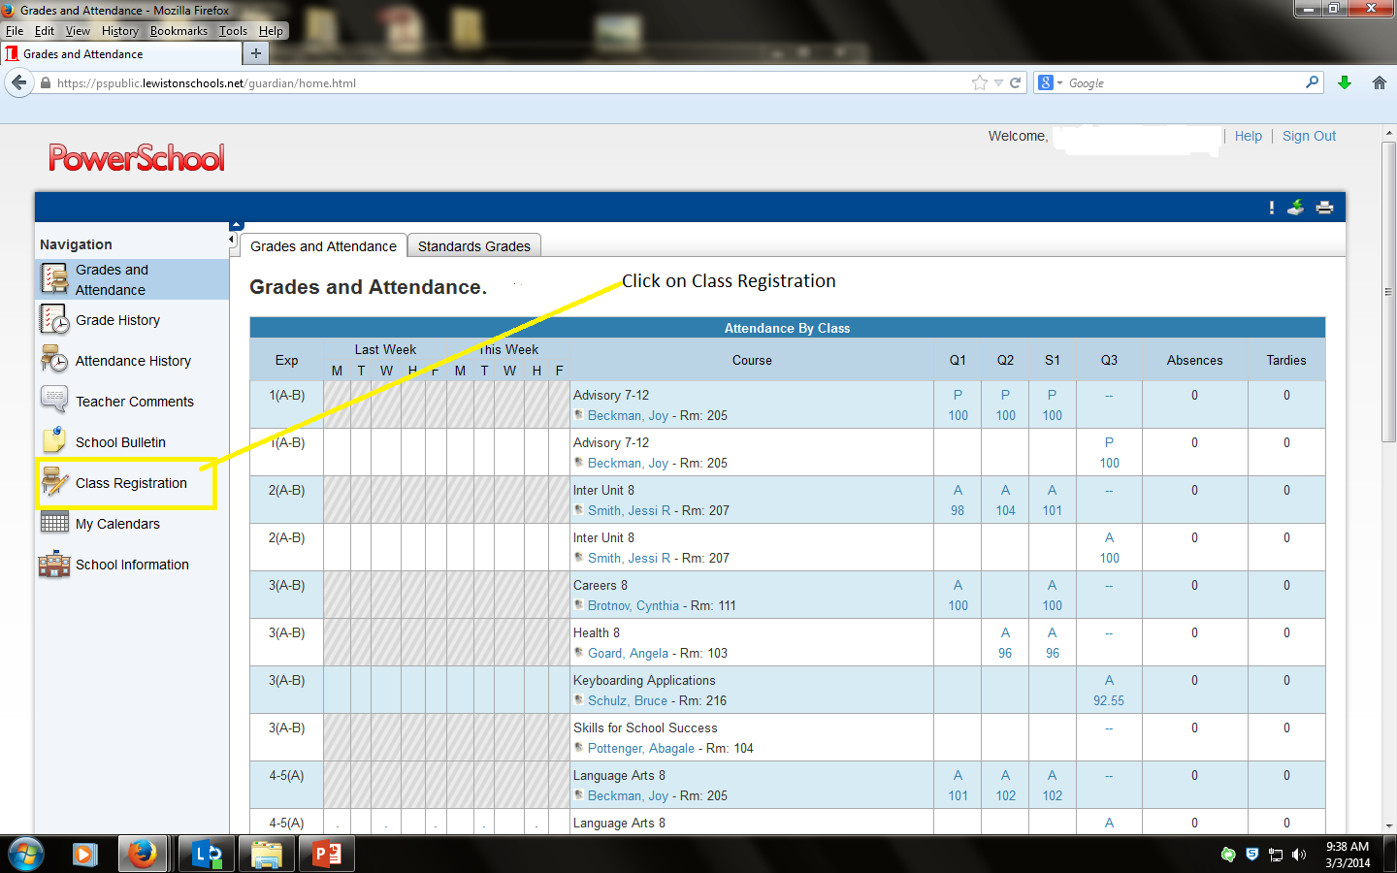

Slide 12
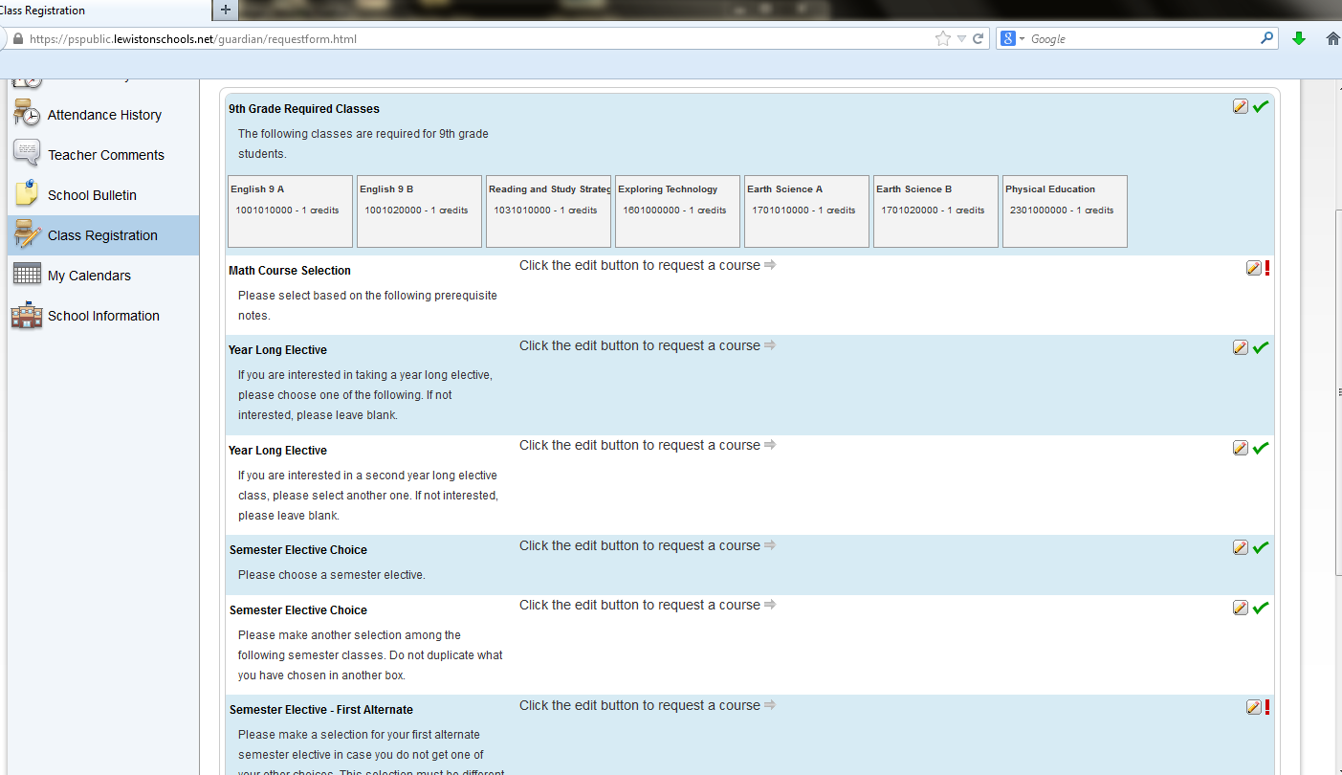
Click the pencil to the right to select courses. Red exclamation means an entry is required. Click on the submit button on the bottom once you have entered your classes.

Slide 13
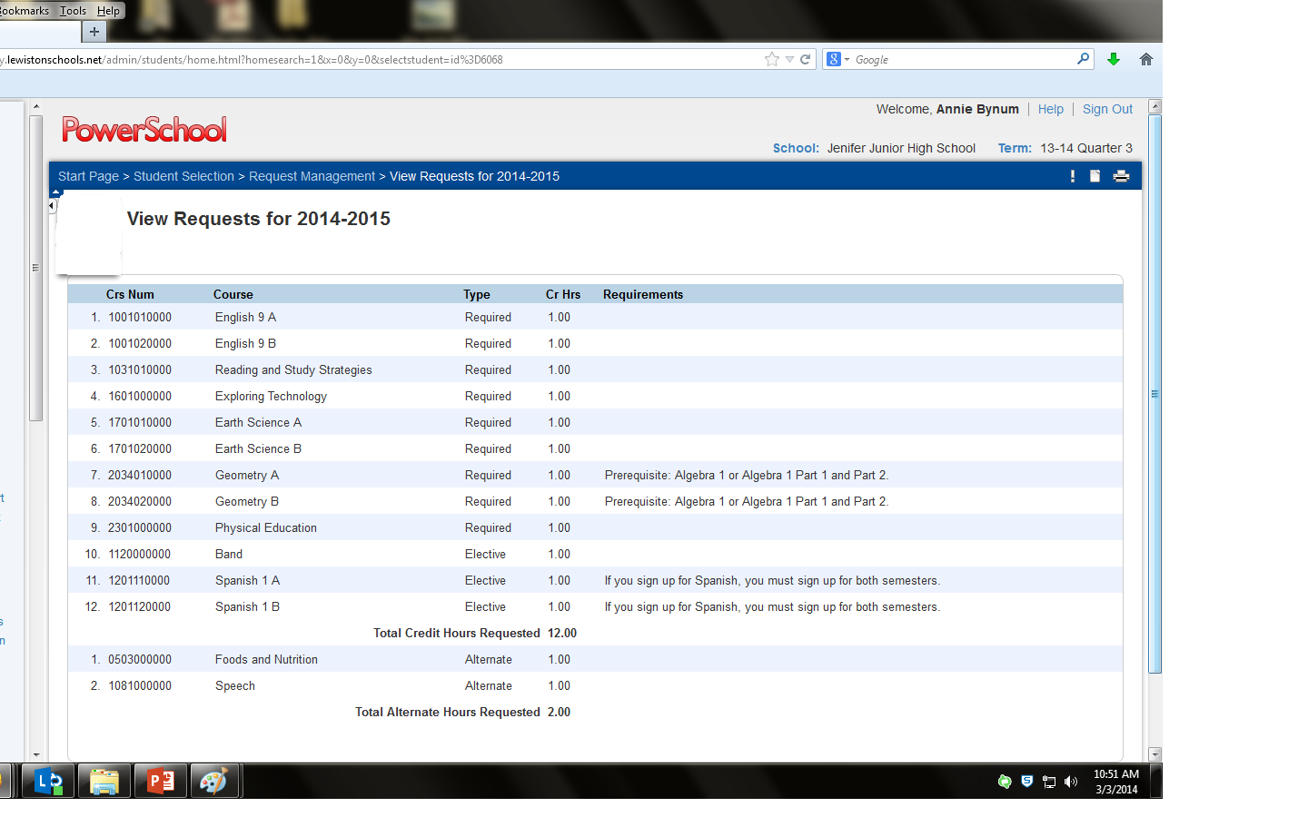
This screen should appear. Please make sure this screen corresponds with your student’s blue registration form.

Slide 14
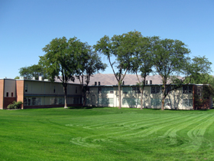
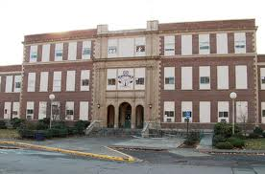
Thank you for coming!

